Slide 1
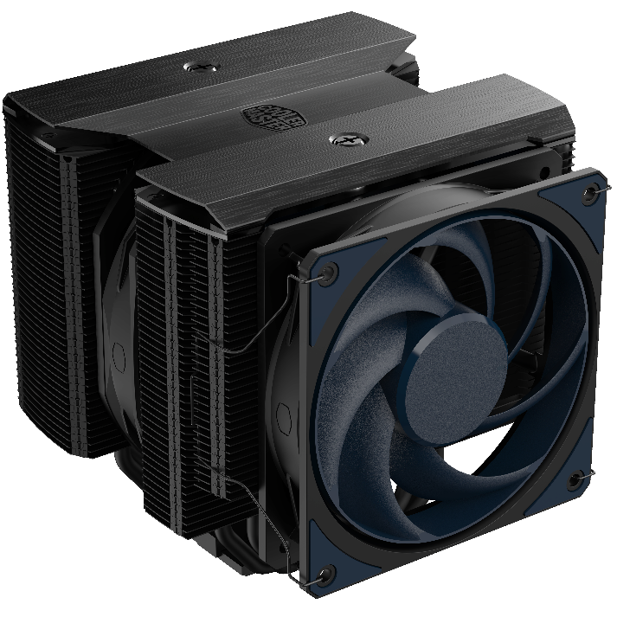
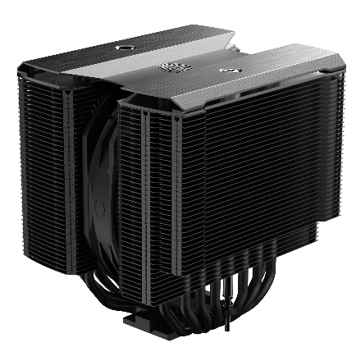
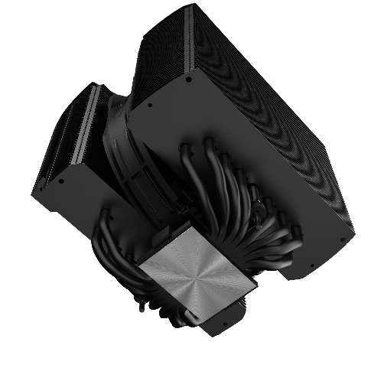
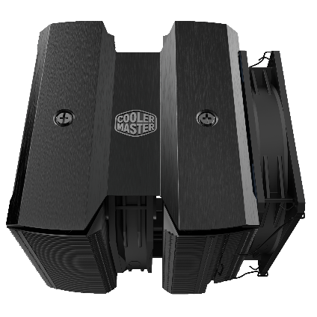
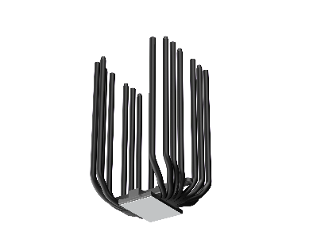
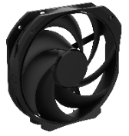
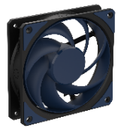
Cooler Master is unveiling its flagship air cooler and newest addition to the Stealth Series – the MasterAir MA824 Stealth. With an impressive 8 heat pipe, dual tower design the MA824 Stealth delivers unmatched performance in its class. It carries the Stealth identity with total blackout accents and design. The redesigned dual tower features 8 of the in-house designed Superconductive Composite Heat Pipes, with variable thicknesses for ultra efficient heat dissipation. Upgraded with a Mobius 120 fan for performance and 43mm of RAM clearance, the staggered Push-Pull setup along with the 135mm performance fan provide absolute cooling. The full coverage nickel plated copper base provides total and seamless contact with the CPU. The MA824 Stealth is bringing performance ready to overshadow its competition.
MA824 STEALTH
Performance Dual Tower
Seamless Contact Copper Base
Signature Stealth Design
Re-engineered performance dual tower with refined fin thickness and gap to maximize surface area.
Full coverage nickel plated copper base provide seamless contact and complete coverage with CPU.
Signature Stealth Series aluminum black top cover adds a clean and simple design look.
Dual Staggered Fan Setup
RAM Clearance
8 Superconductive Composite Heat Pipes
Upgraded Mobius 120 and 135mm Push-Pull fan work in tandem with performance dual towers to deliver unmatched cooling performance and rapid heat dissipation.
42mm of RAM clearance with the 120mm Mobius fan to fit a wide range of builds without sacrificing performance.
8 Superconductive Composite Heat Pipes utilize groove and powder with dual variable thicknesses allow for specific targeted heat transfer throughout the cooler.

Slide 2
Dual Tower Push-Pull – Dual heat sinks with dual fan push-pull setup for impressive cooling.
8 In-house designed Heat Pipes – 8 Superconductive Composite heat pipes developed by in-house design utilize dual variable thicknesses allow for specific targeted heat transfer.
Mobius 120 and 135mm Fan – Upgraded Mobius series fans provide unmatched cooling performance.
Signature Stealth Design – Signature Stealth Series black aesthetics provide clean and sleek accents.
RAM Clearance – 42 mm of RAM clearance provide expanded compatibility without sacrificing performance.
Seamless Contact Copper Base – Full coverage nickel plated copper base provide seamless CPU contact.
Product Name | MasterAir MA824 Stealth
Product Number | MAM-D8PN-318PK-R1
Exterior Color | Black
CPU Socket | Intel® LGA 1700 / 1200 / 1151 / 1150 / 1155 / 1156 socket
 | AMD® AM5 / AM4
Dimensions (Lx W x H) | 162.2× 150.6 × 165.6mm (6.3 x 5.9 x 6.5 inch)
Heat Sink Material | 8 Heat Pipes/ Aluminum Fins
Fan |  | 135mm Fan | 120mm Fan
 | Dimensions (L x W x H) | 135 x 135 x 26mm | 120 x 120 x 25mm
 | Profile | Non-Led | Non-Led
 | Quantity (pcs) | 1 PC | 1 PC
 | Speed | 0~1550RPM ± 15% | 0~1950RPM ± 15%
 | Airflow (Max) | 107.9m³/h (63.6 CFM) | 107.1m³/h (63.1 CFM)
 | Pressure (Max) | 1.92 mmH₂O | 2.69 mmH₂O
 | MTTF | >200,000 Hours | >200,000 Hours
 | Noise Level (Max) | 24.6 dB(A) | 22.6 dB(A)
 | Bearing | LDB | LDB
 | Power Connector | 4-Pin PWM | 4-Pin PWM
 | Rated Voltage | 12 VDC | 12 VDC
 | Rated Current | 0.1 A | 0.12 A
 | Safety Current | 0.25 A | 0.25 A
 | Power Consumption | 1.2~2.4 W | 1.44~3.0 W
Warranty | 5 years
EAN code | 4719512130803
UPC code | 884102103124
Net weight | 1.63kg
Gross weight | 2.25kg
Package dimension (L x W X H) | 24.8 x 19.1 x 24.3 cm
Carton dimension (L x W x H) | 52 x 40.5 x 27.8cm
Units/CTN | 4
Cont. | W/ Pallet | Carton/ Pallet | W/O Pallet
20’ | 1232 | 28 | N/A
40’ | 2464 | 28 | N/A
40 HQ | 2816 | 32 | N/A

